Slide 1
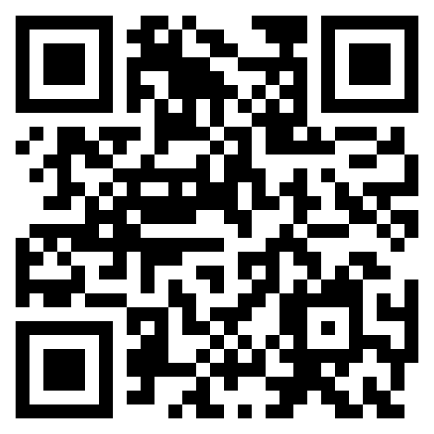
S-T-R-E-T-C-H Your Teaching Professional Development Workshop
April 6, 2024
United Technologies Center, Bangor
9:00-2:30
Keynote Speaker: Jessica Anderson, Attendance Matters: The Basics
Workshop sessions include: positive behavior management, communication skills, early literacy, school gardens, using AI, designing a STEM project, book banning, the power of music and movement, and helping students prepare for employment, college, and citizenship.
Registration Fee:
Early Bird: $35 (before March 8)
Educator - $45
College Student - $15
DKG Member = $25
To register: https://dkgmaine.weebly.com/pd-opportunities.htm
Questions: Mary Hyland, mishyland@gmail.com
Sponsored by Maine State Organization of DKG International

